Slide 1

MTP
Fluid simulation using Deep Learning Methods
Team
Mentor : Dr. Gaurav Bhutani
Members
Piyush Bafna B17020
Shashi Kumar Fagna B17141
Toshendra Rustagi B17147

Slide 2
Flow of Presentation
Content in order
Fluid Simulation Application
Traditional Methods
Why deep learning?
Problem Statement
Literature Survey
Our Model
Result
Planning
Progress so far

Slide 3
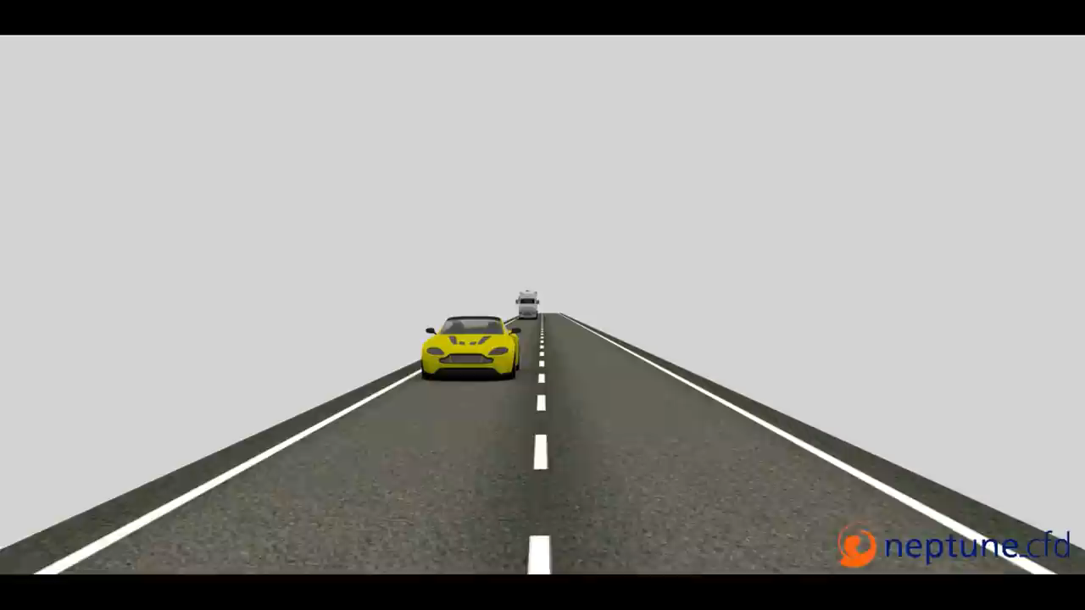
Fluid sloshing in tank truck

Slide 4
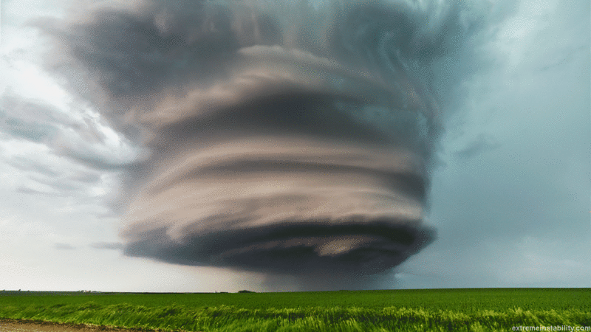
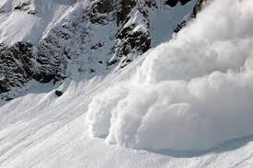
Fluid Simulation Application
Analyzing fluid sloshing in tank truck
For games
Natural Disaster - Modelling of Avalanche , Floods in cities etc.
Modelling of Dam Break.
Cooling system of electronic devices.
Tornado formation

Slide 5
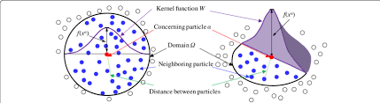
Traditional Method
Smoothed Particle Hydrodynamics
Position Based Dynamics
Material Point Method

Slide 6
Why Deep Learning?
Traditional Method are computationally and memory expensive.
They are time consuming.
Have Generality vs Accuracy Trade off.

Slide 7
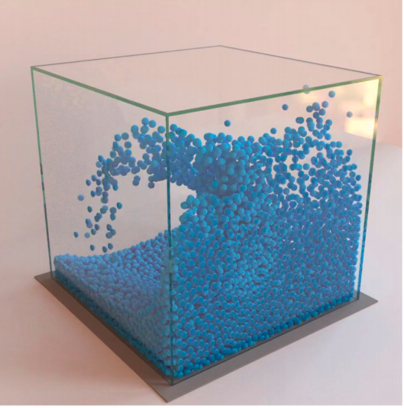
Problem Understanding
Problem statement : To develop a Deep Learning Model for Fluid Simulation using Data generated from physics fluid simulators.
Aim of the project : To make a improvised deep learning model that is robust to hurdles and can be used for a variety of fluids and deformable materials under challenging domains.
Reference : https://arxiv.org/pdf/2002.09405.pdf

Slide 8
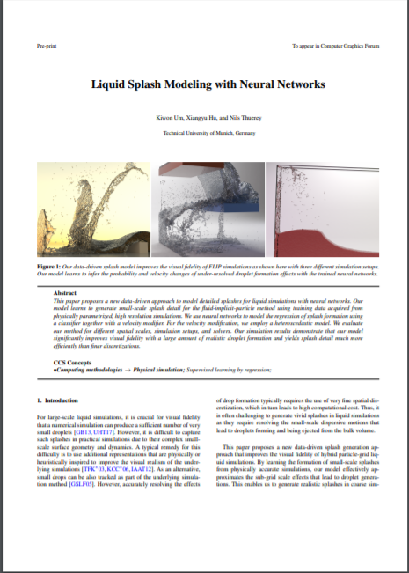
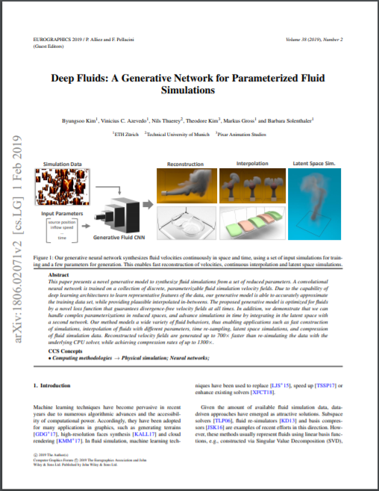
Literature Survey

Slide 9
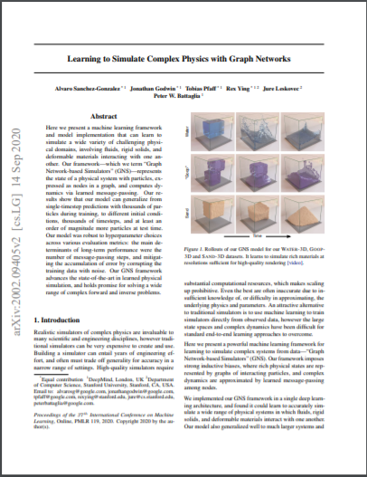
Literature Survey

Slide 10
Our Model: GNS Framework
Graph Network-based simulator framework is single deep learning architecture. This framework can be used to learn to simulate complex physics problems. It is found that GNS can learn to accurately simulate a wide range of physical systems in which fluids, rigid solids, and deformable materials interact with one another.
The framework imposes strong inductive biases, where rich physical states are represented by graphs of interacting particles, and complex dynamics are approximated by learned message-passing among nodes.
Reference : https://arxiv.org/pdf/2002.09405.pdf

Slide 11
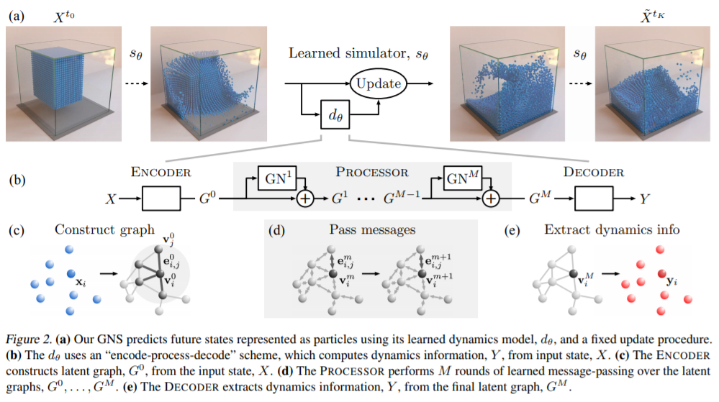
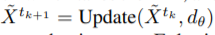
GNS Framework: Working

Slide 12
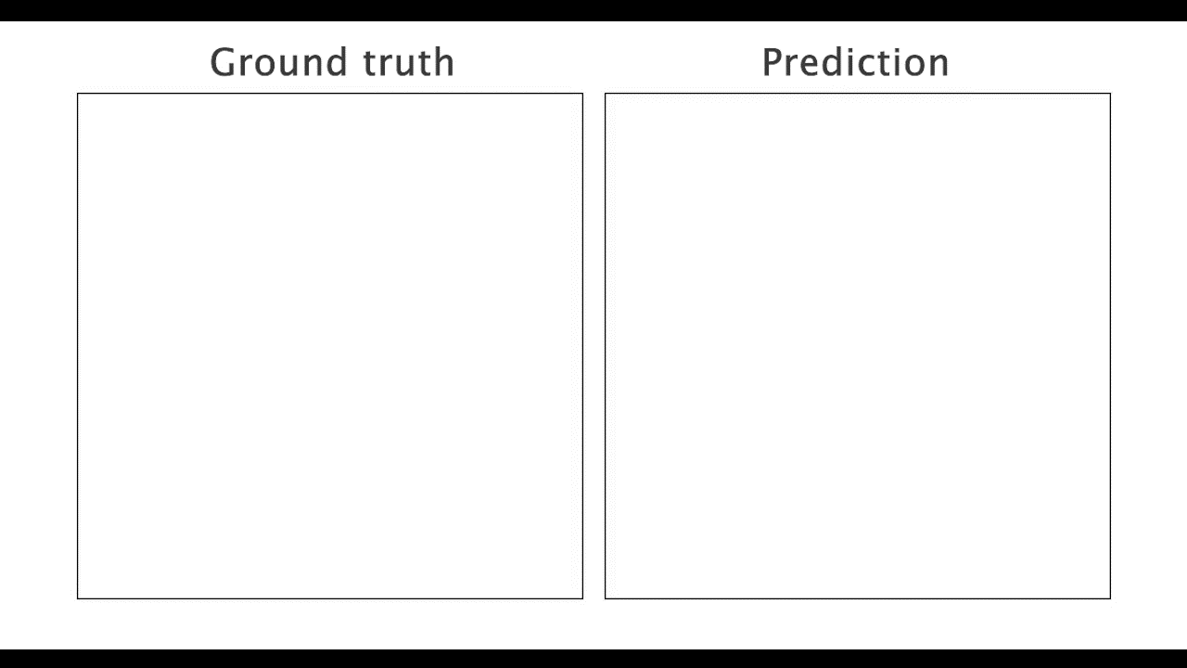
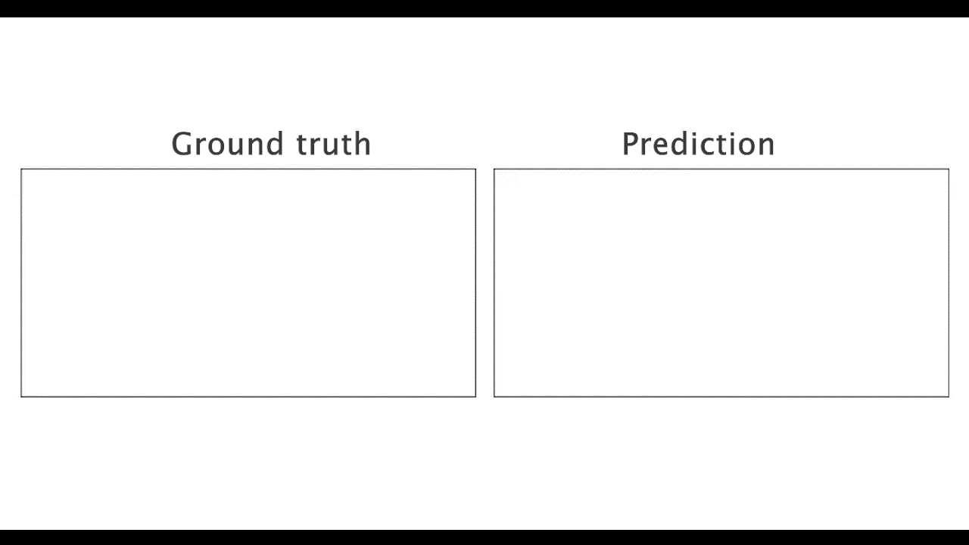
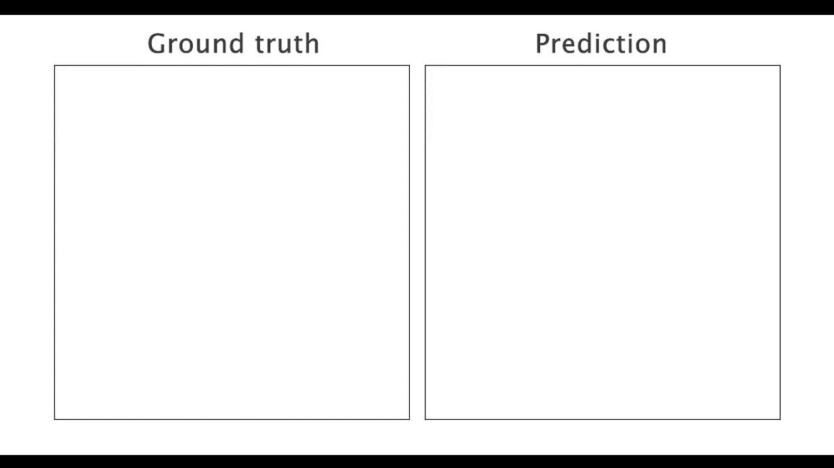

Result

Slide 13
Planning
We have divided the project into 5 sub-task:
We are done with understanding and replicating the previous work. Currently, we are brainstorming the new model/architecture.
Literature study & replication of previous Deep Learning Model. | Sept - Oct 2020
Brainstorming new model/architecture. | Nov 2020
Implementing & Pipelining new model/architecture. | Dec 2020 -Jan 2021
Experimenting with hyperparameters of new Deep Learning Model. | Feb - April 2021
Generalization of Model w.r.t. fluid type , scale and obstacles and Report submission | May 2021

Slide 14
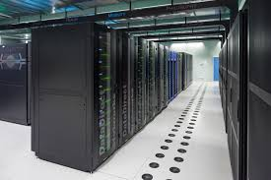
Progress so far…
Done thorough understanding of previous work and replicated it to match the results.
Brainstorming with mentor and previous team.
Literature survey on the state-of-the-art technique for fluid simulation.
HPC accounts setup done.

Slide 15
Thank You

